Slide 1
WEB DEVELOPMENT
Name : Kiran Gungaji Nikam
Date : 06/10/2023

Slide 2
OUTLINES
Introduction to Web Development
Key Technologies and Languages
Frontend Development
Backend Development
Conclusion

Slide 3
WEB DEVELOPMENT
Web development refers to the creating, building, and maintaining of websites. It includes aspects such as web design, web publishing, web programming, and database management. It is the creation of an application that works over the internet i.e. websites.
The word Web Development is made up of two words, that is:
Web : It refers to websites, web pages or anything that works over the internet.
Development : It refers to building the application from scratch.

Slide 4
Key Technologies and Languages
Web Development can be classified into two ways:
Frontend Development :
HTML
CSS
Javascript
Backend Development :
PHP
Node.js
Ruby

Slide 5
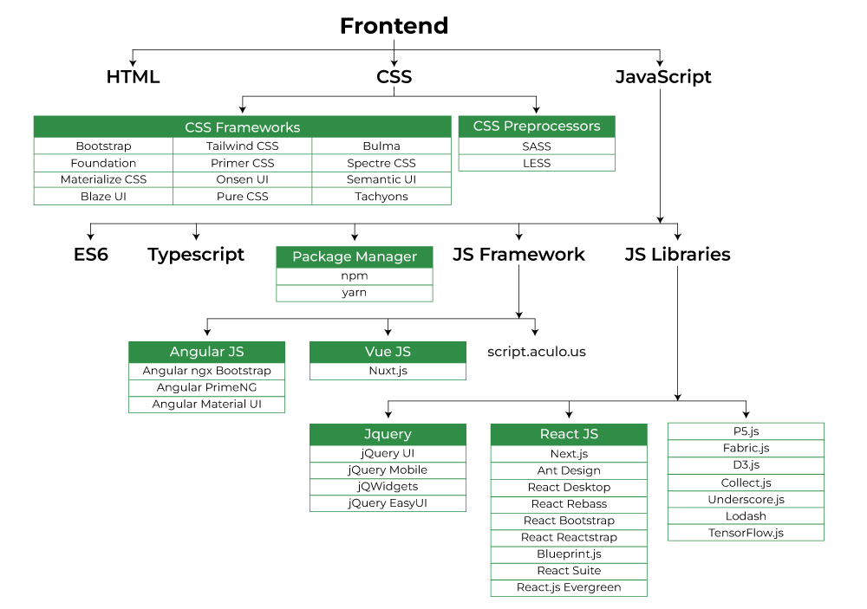
Frontend Development
The part of a website where the user interacts directly is termed as front end. It is also referred to as the ‘client side’ of the application.

Slide 6
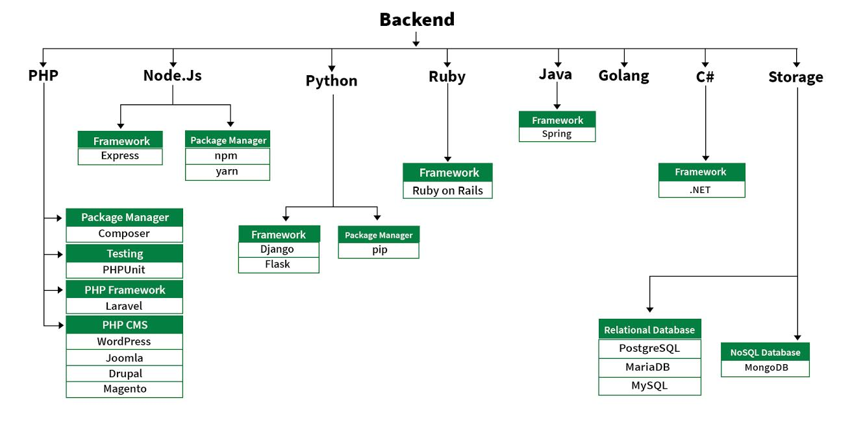
Backend Development
Backend is the server side of a website. It is part of the website that users cannot see and interact with. It is the portion of software that does not come in direct contact with the users. It is used to store and arrange data.

Slide 7
Conclusion
web development is a dynamic and essential field that continues to evolve as technology advances. We've explored the key components of web development, including front-end and back-end development, web design, and the importance of responsive and user-friendly websites. Thank you for your attention, and I'm here to answer any questions you may have.

Slide 8
Thank You !..

